Slide 1
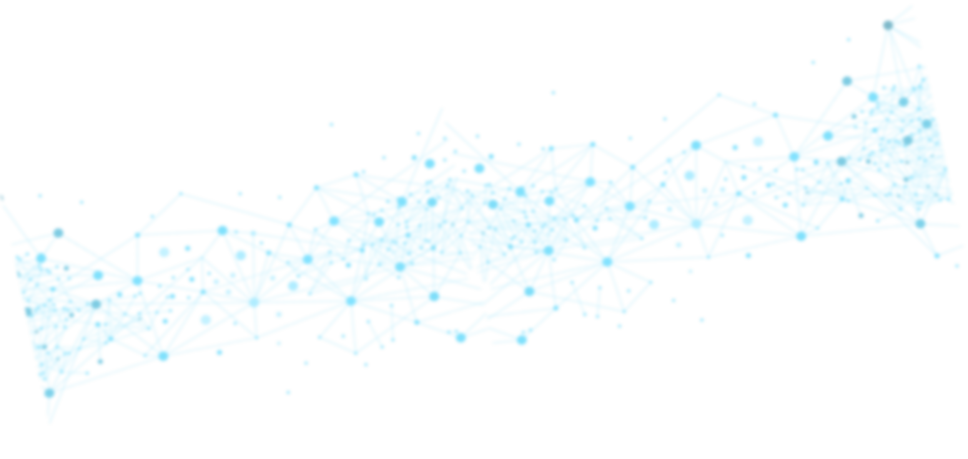



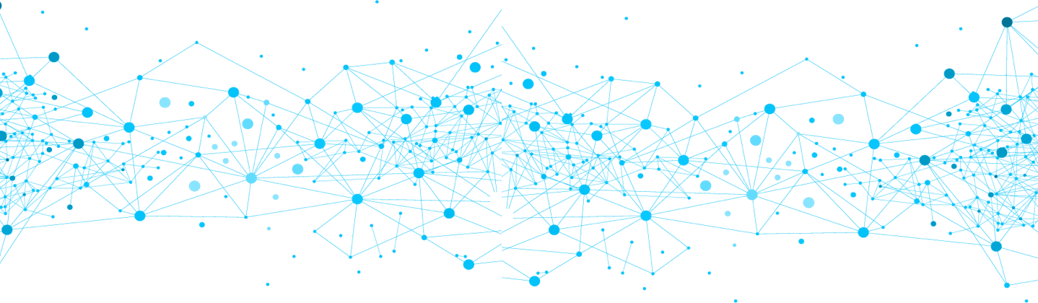

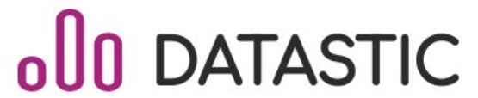

FLOOID Network
Final presentation
Fontys DDBL Minor
Eindhoven, January 2022

Slide 2
Flooid
network
Content
Content
Introduction
Research questions
Process Overview
Results
Web scraping
Docker
NLP
Neo4j graph
Demo
Business Plan
What went well / wrong
Conclusion
Recommendations
Transfer
Thanks

Slide 3
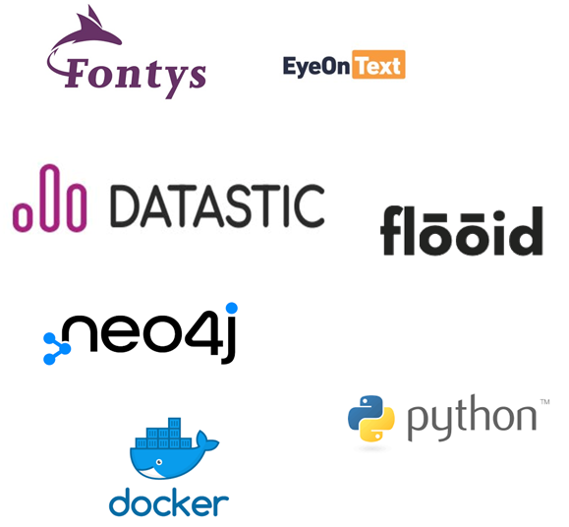

Flooid
network
Introduction
Introduction
Overview
Problem description
Solution
Project Logistics

Slide 4

Flooid
network
Research questions
Research questions
How to design an information network to enable its’ members to increase transparency and data flow?
?
What are the community's needs for the network?
?
What kind of data should be in network?
?
How can Datastic make a network using the tools (web scrapping, NLP, graphs) that are chosen?
?
How can the data from network be stored?
?
How can the network be presented to the end-user?
?
How can this project be transformed to a business?

Slide 5
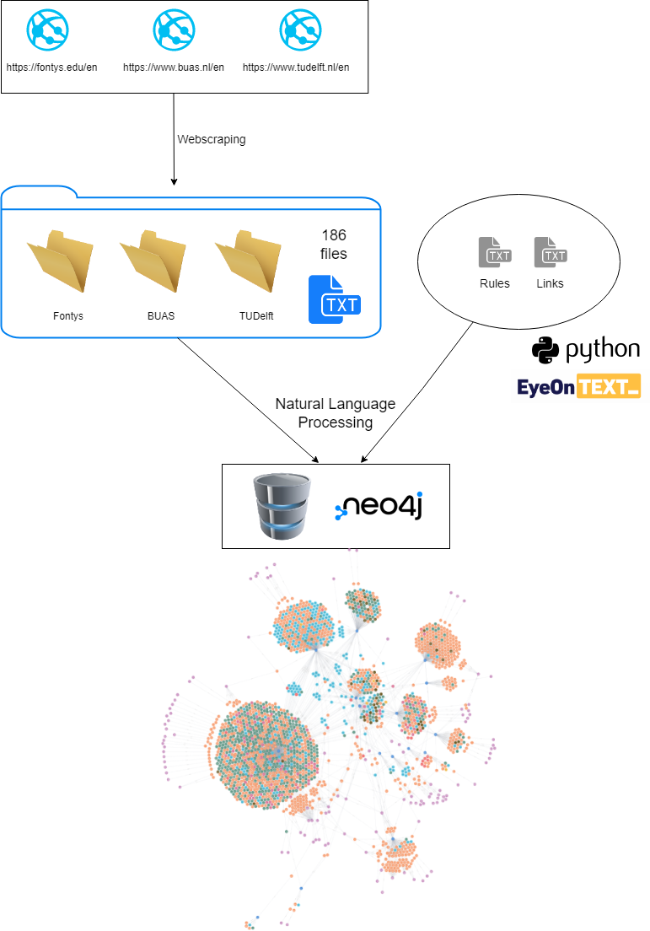
Flooid
network
Process Overview
Process
overview

Slide 6
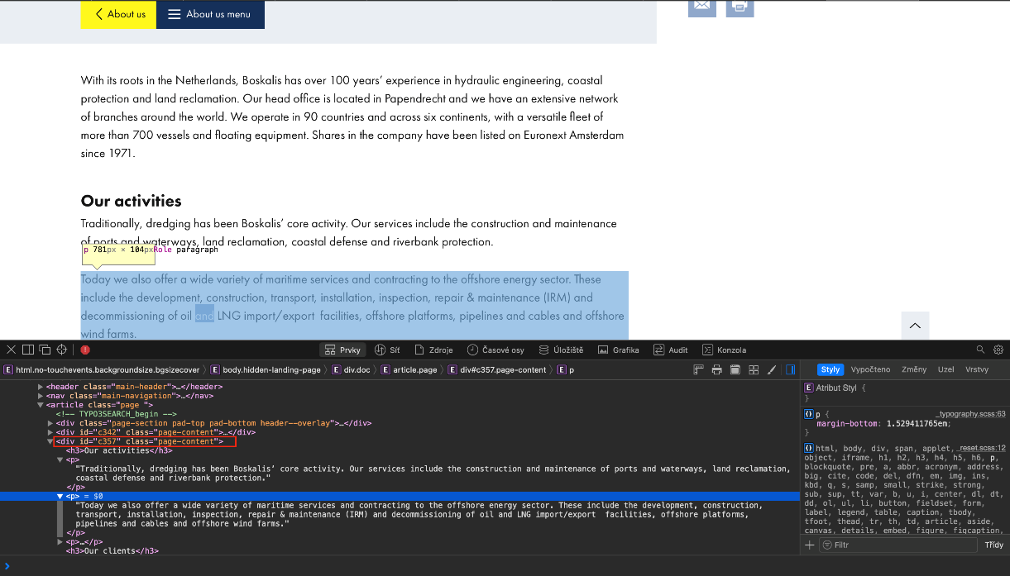

Flooid
network
Web scraping 1
Web scraping
2 approaches
extracting
specific
information
extracting
the whole
page content
Main problem
=
different
websites
different
web structure

Slide 7
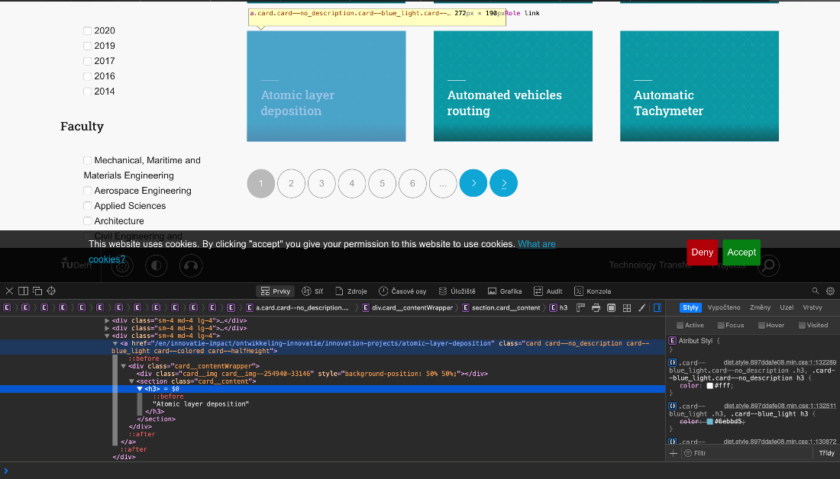
Flooid
network
Web scraping 2
Extracting universities‘ projects (Fontys, TU Delft, BUAS)
Using URL-structure
Result
Folders with scraped content
University projects

Slide 8
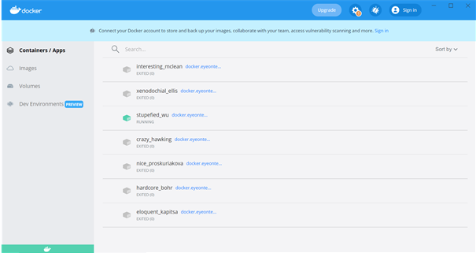
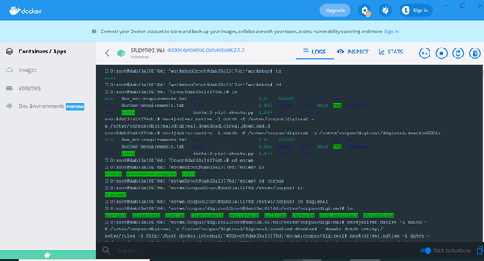

Flooid
network
Docker
Docker
Open platform for running applications
There are containers included in the software.
Provides connection to Neo4j

Slide 9




Flooid
network
NLP 1
Natural Language Processing (NLP)
NLP - Interaction between computer - human
Speech recognition
Language generation
Machine translation
Natural language understanding
WoWool language (text-oriented pattern matcher engine) main components:
Lexicons (like vocabulary)
Easiest way to annotate, just matching literal or stems; add knowledge of the world, simplify rule writing.
Rules (like grammar)
The use of rules in the creation of larger and more complex patterns.
Links file
Used to set a connection between needed topics and create visual relationship between them.

Slide 10
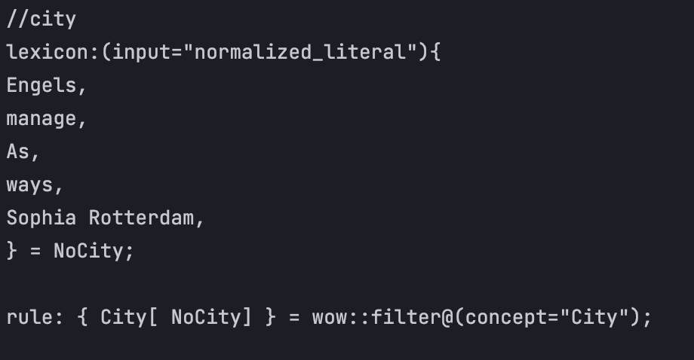
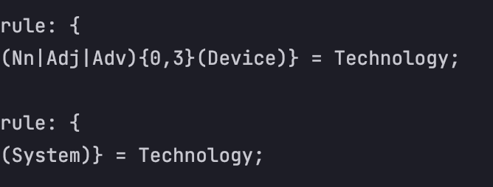
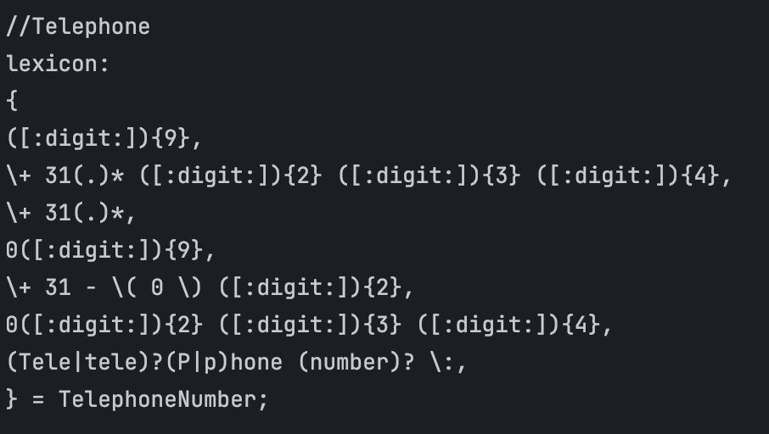
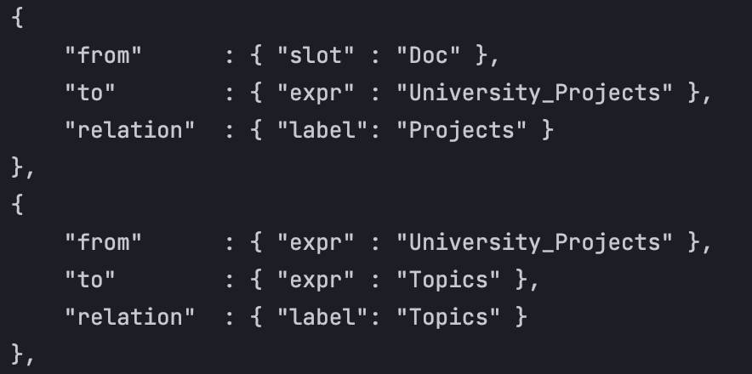
Flooid
network
NLP 2
Lexicons
Rules
Links file

Slide 11
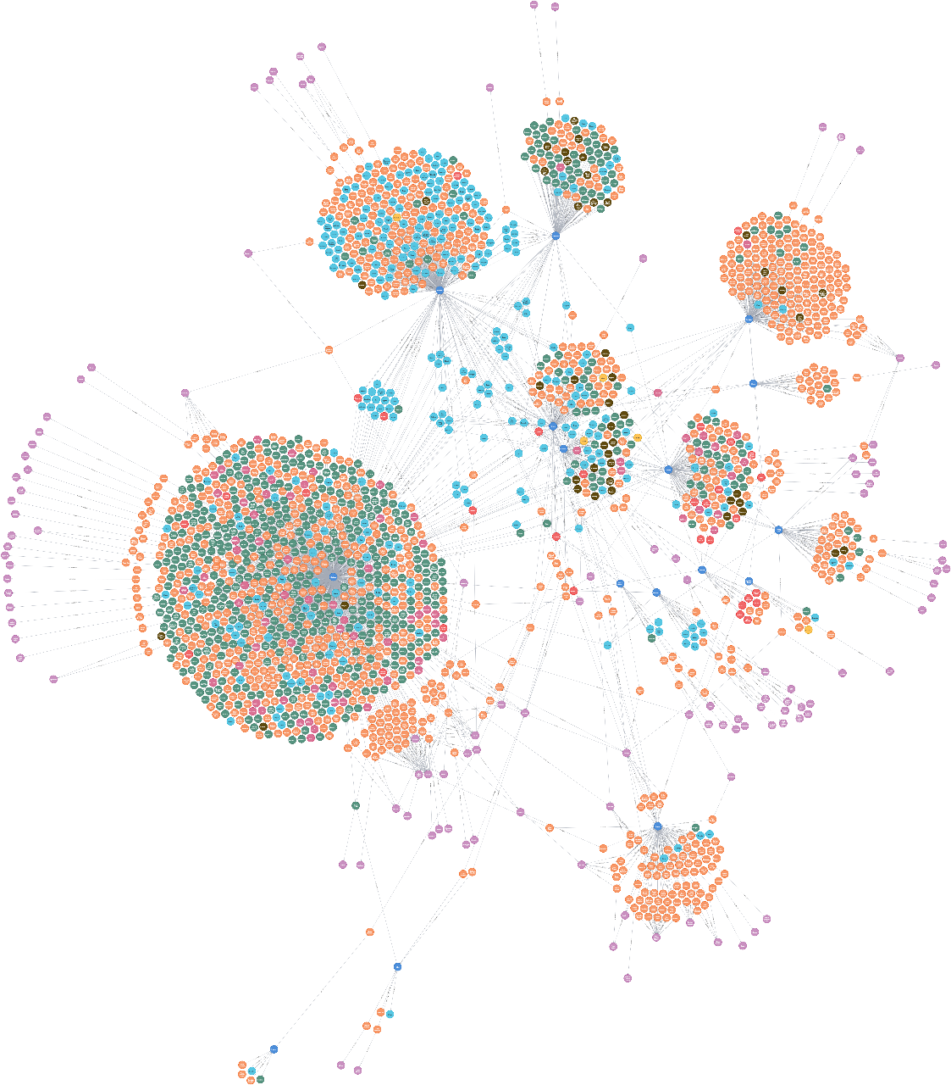
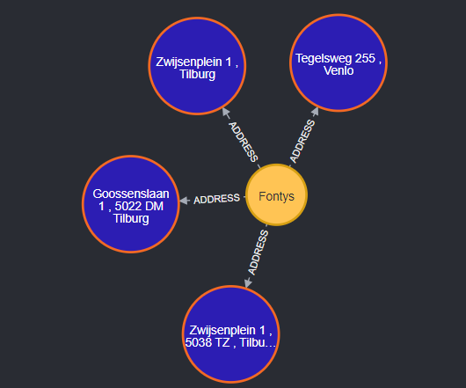
Neo4j graph
Neo4j graph 1
Flooid
network

Slide 12
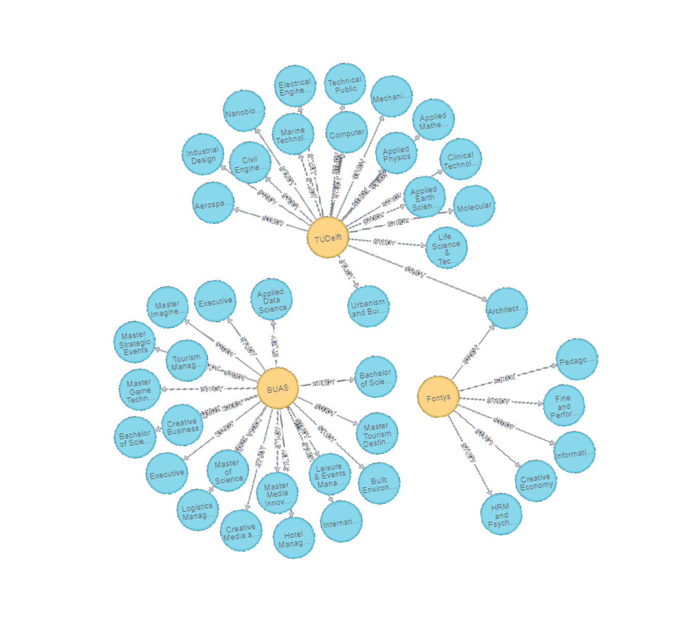
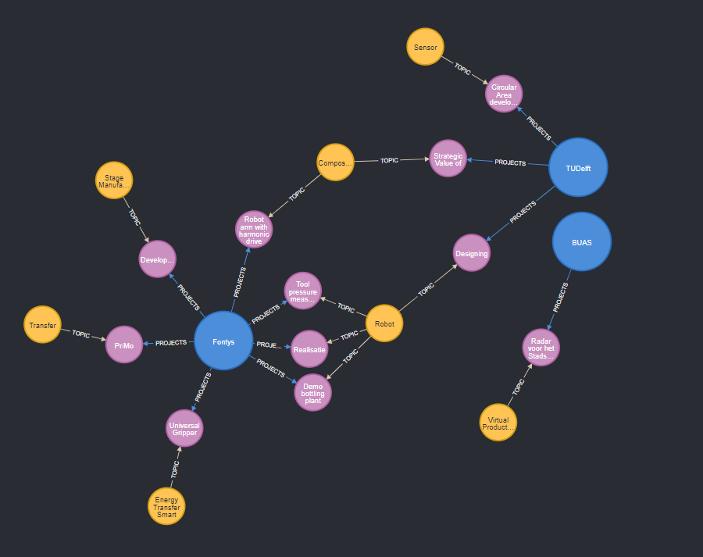
Flooid
network
Neo4j graph 2

Slide 13
Flooid
network
Demo
Demo

Slide 14
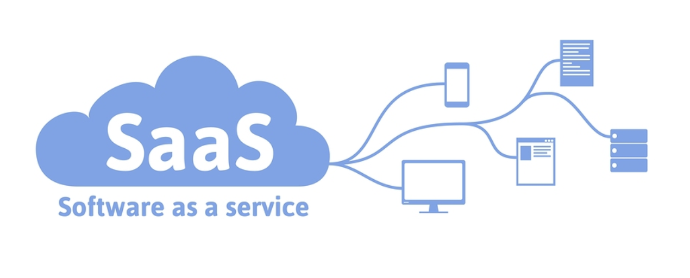
Marketing strategy:
Flooid
network
Business Plan
Business Plan
Strategy:
Promotion
SWOT and TOWS analysis
Packaging
Micro environment
Target setting
Meso environment
Competition and competitors
Macro environment
Socio-cultural aspect

Slide 15


Flooid
network
Problems
What went well / wrong
Web scraping
Cypher queries
Business plan
Different page structure
NLP
Large graph database

Slide 16
Flooid
network
Conclusion
Conclusion
Community’s needs
Data
Tools
Data storage
Front end

Slide 17
Flooid
network
Recommendations
Datastic recommendations
User friendly environment for non-technical end-users
Updates on Manual document
Gather more data from the end-user directly
Ethics and Law

Slide 18




Flooid
network
Transfer
Transfer Documents
Python scripts
Web scraped files
Github repository
Research report

Slide 19
Flooid
network
Thanks
Thank You!
Datastic company expresses its gratitude to:
Stefan
Groenendal
Mark
de Graaf
Simona
Orzan
Rob
Verhoeven
Partner
Partner
Content
Coach
Process
Coach
Rene
Katerberg
Philippe
Forest
Carolina
Rubio
Bart
van Gennip
Partner
WoWool
Specialist
WoWool
Specialist
Minor
Coordinator

